Slide 1
IOT Analytics Proposal
Ivan Sokolenko

Slide 2
Background:
IOT Analytics has been asked to conduct research and present a product to help improve the power management of Smart Homes.
The analysis is conducted on a new set of sub-metering devices used for power management.
47 months of energy usage data is used to provide insights into Smart Home’s power consumption.
The goal is to provide interactive visualizations for Smart Home owners using dashboard style app, that can show power consumption per any selected time period and advise home owners on the best energy rate times.

Slide 3
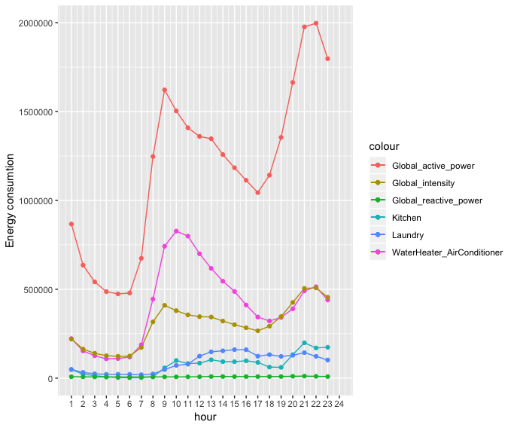
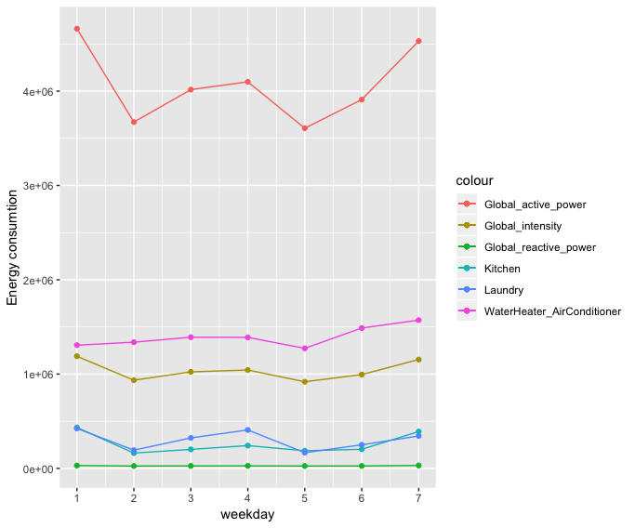
Real-time energy pricing & consumption:
Using information provided by the energy supplier, we can update energy rates for peak and off peak times, notify home owners of high fare rates (Uber style).
Combining energy consumption data from each sub meter with energy rates, we will make it easier to manage day-to-day activities, such as water usage, laundry, heating etc.

Slide 4
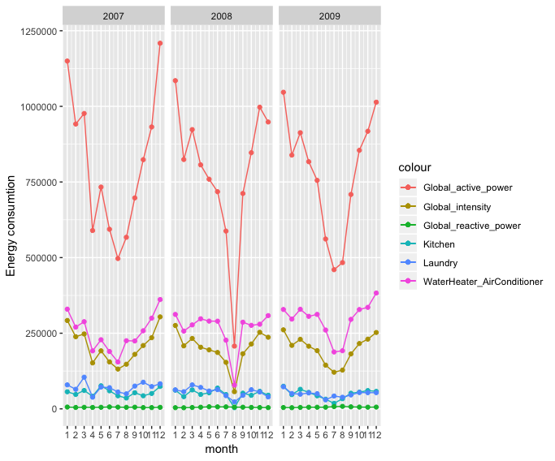
Forecasting future expenses:
Based on previously collected energy consumption data, we can forecast future energy bills, which will make it easier for home owners to plan their finances.

Slide 5
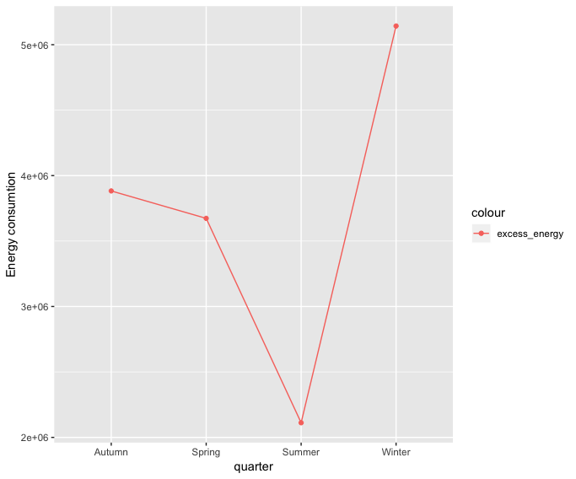
Recommendations:
In order to maximize the energy efficiency while using our application, we recommend to have every electronic device/socket connected to the sub metering system.
i.e. TVs, sockets that are used for charging electronic devices such as phones, laptops, hair dryers, lightning bulbs.

Slide 6
Costs & Timeline:
The following project will take 1 month: 1 week for data analysis, 3 weeks for coding + continuous revisions.
We will provide a fully functioning dashboard style interactive application.
Estimated cost of this project is 7000 euros.
Additional personalized insights/behavioral patterns will be added at extra cost.

Slide 7
Thank you

